Slide 1

Intro to Web Development with React.js
Notes:
0:00
Say: Welcome everybody! Since we’re running this presentation remote, we are going to be patient for a few minutes and let others join. We will officially kick off the presentation in about 5 minutes. While we wait, let’s use the chat functionality to answer a few questions so that we can get to know each other a bit more.
Next Slide

Slide 2
Did you get through the prerequisites?
Respond through chat
Y or Yes
N or No
Notes:
0:01
Ask: Did you get through the prerequisites?
You can respond through the chat by typing Y/Yes, or N/No.
------------------------------------------------------------
Wait 1 min for responses.
------------------------------------------------------------
Say: If you weren’t able to get through all of the instructions, that’s OK! Getting a computer ready for coding is no easy task, and there are so many steps that can behave differently from one computer to the next. If you have any questions or want to talk about a problem that you faced while trying to follow our instructions, please ask your question in the chat. We will do our best to help you get the problem resolved so that you can follow along with the rest of our workshop.
--------------------
Next Slide

Slide 3
Have you ever written code before?
Respond through chat
Y or Yes
N or No
Notes:
0:04
Ask: Have you ever written code before?
You can respond through the chat by typing Y/Yes, or N/No.
------------------------------------------------------------
Wait 1 min for responses.
------------------------------------------------------------
Say: Coding, or software development, is a skill that can be used in so many different ways. There is no single “right way” to learn how to program or build software. Everybody that learns how to start writing code starts somewhere. For some people,
--------------------
Next Slide

Slide 4
How often do you learn by reading things on the internet?
Respond through chat
C or Constantly
D or Daily
W or Weekly
N or Never
Notes:
0:06
Ask: How often do you learn by reading things on the internet?
------------------------------------------------------------
Wait 1 min for responses.
------------------------------------------------------------
Say:
--------------------
Next Slide

Slide 5

This workshop is part of a series:
Part 1: Intro to Web Development Concepts
Part 2: Hands on / Deep Dive with React
Notes:
0:08
Say: This workshop is part of a series! The first part, which is what you are attending today, is going to help explain some of the different parts of web development and prepare you for the next part(s) in the series. We may continue building on this workshop series, so remember that any feedback that you provide in follow up surveys will be very helpful and will help make these presentations as helpful as they can be.
Next Slide

Slide 6

Welcome!
What is a web page?
HTML
JavaScript
CSS
Intro to React
How to learn more about modern web development
Q&A
Notes:
0:09
Say: Let’s take a look at our agenda.
Read slide

Slide 7

Welcome!
Why do we want to talk about this today?
Building a web page is a free method to get your voice heard, express your creativity or build a business
You are in control of your own message; there are no moderators to control whether your content is seen by the people that need to see it
You can share your web site with whoever you choose!
Notes:
0:09
Say: So, why do we want to get you interested in web development? Well, journalism, photography and creative arts have always been
Next Slide

Slide 8
What is the web?
The web is an information system where documents are identified by URLs, such as https://www.google.com.
These can be linked together, and accessed over the Internet.
Notes:
0:10
Say: Before we start talking about code, let’s make sure that we are all on the same page about what we are talking about when we say “the web” or “the internet”. A lot of us use these tools every day with only a partial understanding of how they work.
Read slide
--------------------
Next Slide
Sources:
- https://en.wikipedia.org/wiki/World_Wide_Web

Slide 9
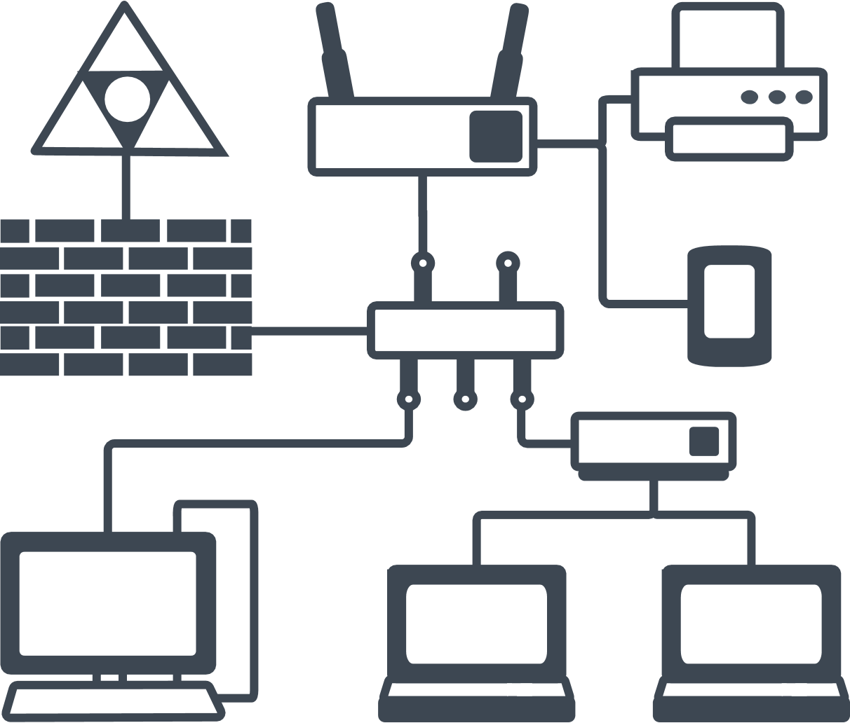
What is the internet?
The internet is a global system of interconnected computer networks that a specific protocol (TCP/IP) to communicate between networks and devices.
Network protocols are sets of established rules that dictate how to format, transmit and receive data so computer network devices – like clients and servers -- can communicate regardless of the differences in their underlying infrastructures, designs or standards.
Notes:
0:12
Say: So what is the internet, then?
Read slide
So:
The web is the information system that you might already be very familiar with
The internet is the way all of our computers talk to each other
The data is everything that we send and receive, such as images, videos and documents. A web page is just a form of document!
--------------------
Next Slide
Sources:
- https://en.wikipedia.org/wiki/World_Wide_Web

Slide 10
How do web browsers work?
Notes:
0:14
Say: Let’s talk about what actually happens when you type in a URL in a web browser.

Slide 11





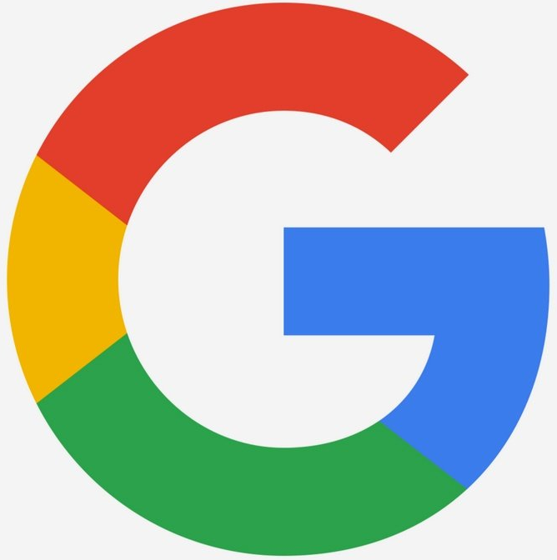
User types in URL and presses “Enter”
Web Browser makes request to server to retrieve webpage
Web server receives the request
Web Browser “renders” the HTML
Web server responds with markup file contents (HTML)
Web Browser requests images, script files and style sheets from server
Web server receives request
Scripts load and begin handling user interaction
Web server responds with JS/CSS/image file contents
Styles load and are rendered resulting in the final appearance of the web page
Notes:
0:14
Click to advance
Say: Let’s talk about what actually happens when you type in a URL in a web browser, such as Google Chrome, Mozilla Firefox or Apple’s Safari.
Click to advance
A user types in a URL (or Uniform Resource Locator) and presses “Enter” or clicks “Go”.
Click to advance
The browser knows how to turn the URL into the address of a real computer’s address that you can then connect to over the internet. The browser connects to the web server and makes a “request” for the “document” that you were looking for. When you type “blackgirlscode.com” your browser requests a file called “index.html”. When you type “blackgirlscode.com/about-bgc.html”, it tells the web server that you are looking for a file at the path of “/about-bgc.html”.
Click to advance
The web server receives the request.
Click to advance
As long as it knows how to find the file you asked for, it will send you the contents of that file. If it can’t find the file or data, it can respond with an error to tell the web browser that the request failed.
Click to advance
When the web browser receives the HTML data, it begins processing this data to ultimately result in what you would expect to see when looking for a web page. This process is known as “rendering”.
Click to advance
As the browser renders the web page data, it will find tags, or little blocks of HTML text, that represents a placeholder for image files, script files, and stylesheets. We will learn more about what each of these pieces do in the next few slides. As the browser finds these tags, it makes additional requests to the web server to retrieve these files.
Click to advance
As the browser requests these files, the web server handles the request and responds with data just like it did for the HTML file.
Click to advance
When the browser receives JavScript or other script files, it begins loading and running them. This means that now scripts can handle user interaction and manipulate the contents of the HTML.
Click to advance
Around the same time, “stylesheets” begin loading and rendering which builds the final appearance of the web page.
When this whole process completes and as long as everything is working as expected, what you see on screen is a fully functional webpage that is ready for you to interact with. Every time you click a button, type something and press enter, or open a new page, the whole process starts again.
Next Slide

Slide 12
What is a web page made of?
Notes:
0:18
Say: Now that we understand the general idea of how a web page gets to our computer, the next step is to look at what a web page is actually made of! There are three main parts that we are going to talk about today, and those are HTML, JavaScript and CSS.
With each of these topics, we have some sample code for you to open on your own computer. We encourage you to try to follow along, because it will help you understand how all of these concepts work and give you something to play with after the session when you decide you want to keep learning more about web development. If you get stuck with any of the exercises, feel free to ask questions in the chat. Some questions might have quick answers, and for others we might recommend you ignore it or skip that section. We will do our best to come back to these questions at the end.
Next Slide

Slide 13
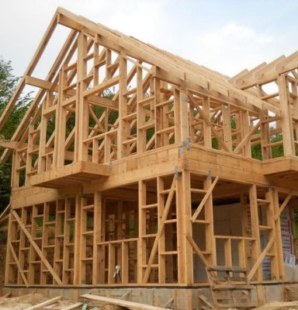
HTML
A markup language
.htm or .html files
Starts with <html>, ends with </html>
Defines what goes on a page, but does not usually define where it will go or what it will look like
In modern times, most HTML is generated by other “higher level” frameworks
Notes:
0:19
Say: The first part of a web page that we will discuss is HTML.
Click to Advance
HTML is a markup language, which means it follows a “syntax” and uses text to describe document attributes and layout elements.
Click to Advance
HTML files end in .HTM or .HTML file extensions
Click to Advance
The code inside of an .html file starts with an element <html> and ends with an ending element </html>. Notice the slash. That is part of HTML’s syntax which makes it easier to see where a block of code starts and where it ends.
Click to Advance
HTML defines what goes on a page but not always where it will go, what it will look like or how it will behave. It’s a lot like the framing of a house, or the bones of a body.
Click to Advance
In modern web development, most HTML is actually generated by other “higher level” frameworks, such as React, which we will talk about later in this workshop. The reason for this is that developers have created better tools for building web pages so now it is faster and easier to write code in a different way than how we used to. We still keep the old HTML structure so that web browsers can still show you old web pages, but new features are often added to browsers that allow cool new things to be done or make web development faster or more enjoyable.
Let’s start our first exercise!
Next Slide

Slide 14
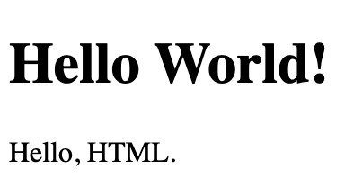
Exercise 1: View Example HTML File
Open Terminal (on Mac) or Powershell (on Windows).
Enter: cd ~/Downloads cd BGC-React-Intro
Enter: open helloworld.html Start-Process "helloworld.html"
MAC ->
What this HTML looks like after being rendered by a browser
WINDOWS ->
Notes:
0:20
Say: Our first exercise is to open an example HTML file using a Terminal, which is program that allows you to use your computer with text commands instead of a normal GUI or graphical user interface. Many web development tools are built to be used this way, so this is good practice for future exercises.
Do Exercise
Next Slide

Slide 15
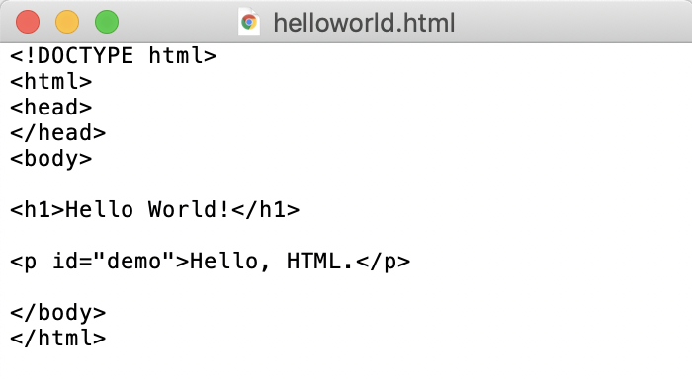
Open Example HTML File
Open Finder (on Mac) or Windows Explorer and open your Downloads folder.
Open BGC-React-Intro.
Right-click helloworld.html.
Go to: Open With → VSCode Open With → More Apps → VSCode
MAC ->
WINDOWS ->
Notes:
0:23
Say: Now we will open the same file, but in a text editor. Remember that our web browser is the application responsible for rendering a web page and showing you the final appearance, but a text editor is a program whose job is to allow you to view and edit the text contents of a file. We can open an HTML file in a text editor to see the raw HTML, rather than the rendered page that a web browser shows us.
Do Exercise
Next Slide

Slide 16
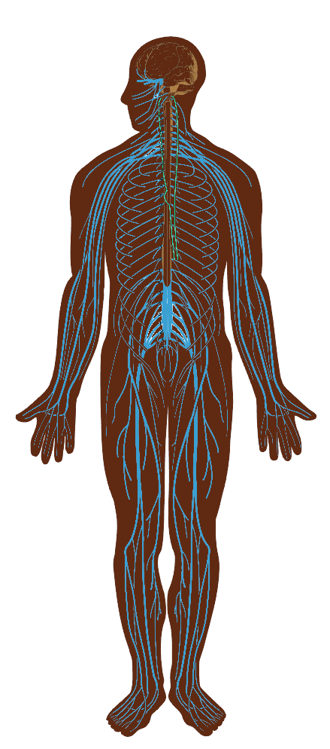
JavaScript
JavaScript defines the behavior and interactivity of a web page.
JavaScript is responsible for deciding what to do when a button is clicked. It can update the HTML of a page to add/remove/update content, retrieve data from other servers (also known as APIs) and so much more!
JavaScript code is usually included by an HTML file, as shown here:
<script src="myscript.js"></script>
As a web browser processes an HTML file and encounters a “script” tag, it will download the contents of that JavaScript file and inject the code right into the HTML.
Notes:
0:25
Say: The next part of a web page that we will discuss is JavaScript.
Click to advance
JavaScript defines the behavior and interactivity of a web page.
Click to advance
JavaScript is responsible for deciding what to do when a button is clicked. It can update the HTML of a page to add/remove/update content, retrieve data from other servers (also known as APIs) and so much more!
Click to advance
JavaScript code is usually included by an HTML file, as shown here:
<script src="myscript.js"></script>
Click to advance
As a web browser processes an HTML file and encounters a “script” tag, it will download the contents of that JavaScript file and inject the code right into the HTML.
Let’s take a look at JavaScript in action with another exercise.
Next Slide

Slide 17
Exercise 2: Add Javascript
Open exercises.txt to find the “button” element.
Click and drag your cursor to select all the button text.
Right-click it, and select “Copy”.
In helloworld.html, find the line that says “Javascript can change…”
Add a couple blank lines below this by pressing the Enter key.
Right-click the blank line, and select “Paste”.
Save helloworld.html (File -> Save).
Refresh the webpage to see the results!
Notes:
0:28
Do Exercise
By following this exercise, you are one step closer to learning all of the amazing and interactive things that JavaScript can do.

Slide 18
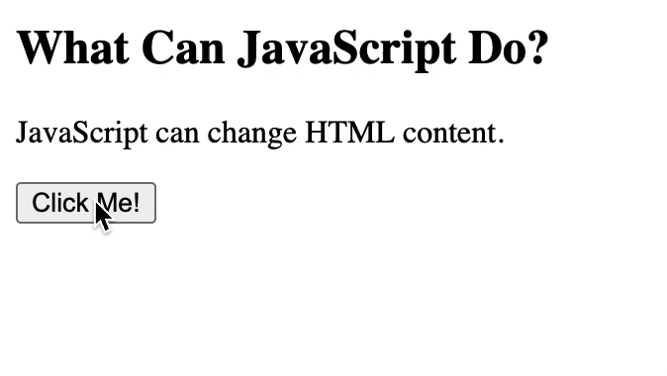
JavaScript Embedded in HTML
Notes:
0:30
Say: This animated graphic shows an example of a button, which is defined in HTML, connected to a JavaScript function that causes the text in the page to change.

Slide 19
Example: JavaScript in A Second File
index.html
<!DOCTYPE html>
<html>
<body>
<p id="demo">A Paragraph.</p>
<button type="button" onclick="myFunction()">Try it</button>
<script src="myScript.js"></script>
</body>
</html>
myScript.js
function myFunction() {
document.getElementById("demo").innerHTML = "Paragraph changed.";
}
Notes:
0:31 - 0:35
In the exercise, we put JavaScript code directly in the HTML file. This works, but would be hard to write complicated behavior into the middle of your HTML structure. The code would get too confusing and would be hard to format nicely to make it easier to read. The solution to this is to put JavaScript in it’s own file, a .js file, and include it via a <script> tag in your HTML.
In this example, the left side is the HTML file and the right side is the JavaScript file. This HTML adds a text block, or “p” for paragraph, and a button to the screen. Then, it includes the script file. The button has it’s “onclick” handler set to the name of the function inside of our script file, “myFunction”. When a web browser loads this page, it knows how to wire up this button to this chunk of code in “myFunction”. When the “myFunction” code runs, it gets an element with the ID of “demo” and change’s it’s “innerHTML” property to new text. This demonstrates a full example of how HTML code can hook up to JavaScript code, and how the JavaScript code can then handle interaction and manipulate the HTML that it is attached to.

Slide 20

CSS
CSS is an acronym for Cascading Style Sheets.
CSS defines the look and feel of a web page by applying “styles” to the HTML elements via “selectors”.
CSS can be used to change all sorts of attributes of a web page, from text appearance (size, font, color, style), to layout elements size, shape and background color, to what happens when a user is hovering over an element.
Notes:
0:35
The last big part of the puzzle is CSS. CSS is responsible for the style/appearance of a web page.
CSS is an acronym for Cascading Style Sheets.
Click to advance
It defines the look and feel of a web page by applying “styles” to the HTML elements via “selectors”. As you saw in the previous example where JavaScript was referring to an element by ID, CSS has the same ability. An element’s ID can be used as a CSS selector, meaning you can attach CSS code to a specific element by using an ID. We will see an example of that in our CSS exercise.
Click to advance
CSS can be used to change all sorts of attributes of a web page, from text appearance (size, font, color, style), to layout elements size, shape and background color, to what happens when a user is hovering over an element.
Although you can write CSS code directly in an HTML file, keeping CSS in a separate “.css” file is a better practice which helps keep your HTML and your CSS code clean and easy to read.
Let’s take a look at a web browser feature that allows us to see and edit the CSS that is responsible for the appearance of a web page like Google.
Next Slide

Slide 21
Exercise 3 Use Web Inspector to Change a Website’s CSS!
Open Google Chrome to google.com
Right click on the search box in the middle of the screen and select “Inspect”
The “Web Inspector” will open and allow you to see the HTML elements, CSS styles and many other important parts of a web page.
As shown in the following video, changing the background-color attribute to red makes the search bar background red.
Notes:
0:39
Do Exercise Steps
The web inspector is a tool that is used every day by web developers. Developers use this tool to find and fix problems with their HTML, test their JavaScript, modify their CSS, and even to run tests of performance or accessibility.

Slide 22
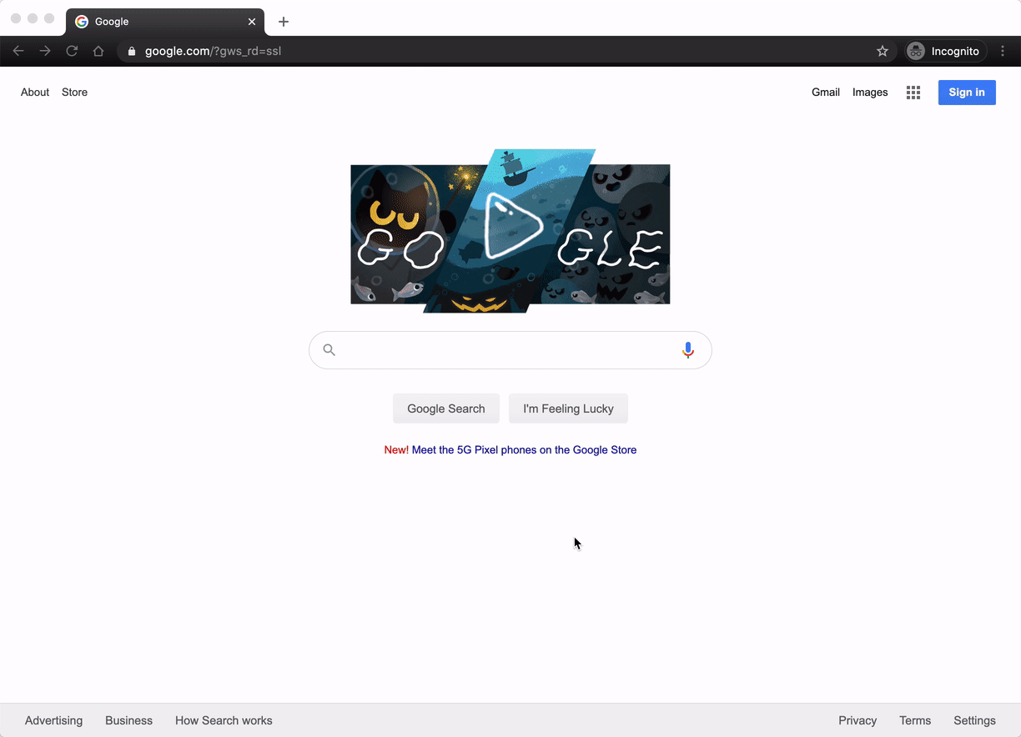
Notes:
0:40

Slide 23
Break
Notes:
0:40 - 0:50
Say: Now that we have gone through the 3 main components of a web page, let’s take a short break. When we come back, we’ll talk about a more modern way of writing code for the web called React.

Slide 24
What is React?
React is a JavaScript library for building user interfaces
React makes it easier to build small building blocks that can be used to make larger building blocks which eventually make up a whole page
React was developed by Facebook and is now published as an open-source project. This means that in addition to the large team of developers from Facebook that work on making React the best that it can be, the rest of the world can also contribute their own improvements and has visibility into the development process of the React ecosystem.
Notes:
0:50
Say:
Welcome back!
We are going to talk about a framework called React.
Click to advance
React is a JavaScript library for building user interfaces
Click to advance
React makes it easier to build small building blocks that can be used to make larger building blocks which eventually make up a whole page
Click to advance
React was developed by Facebook and is now published as an open-source project. This means that in addition to the large team of developers from Facebook that work on making React the best that it can be, the rest of the world can also contribute their own improvements and has visibility into the development process of the React ecosystem.
Next slide

Slide 25
Who is using React?
Notes:
0:53

Slide 26
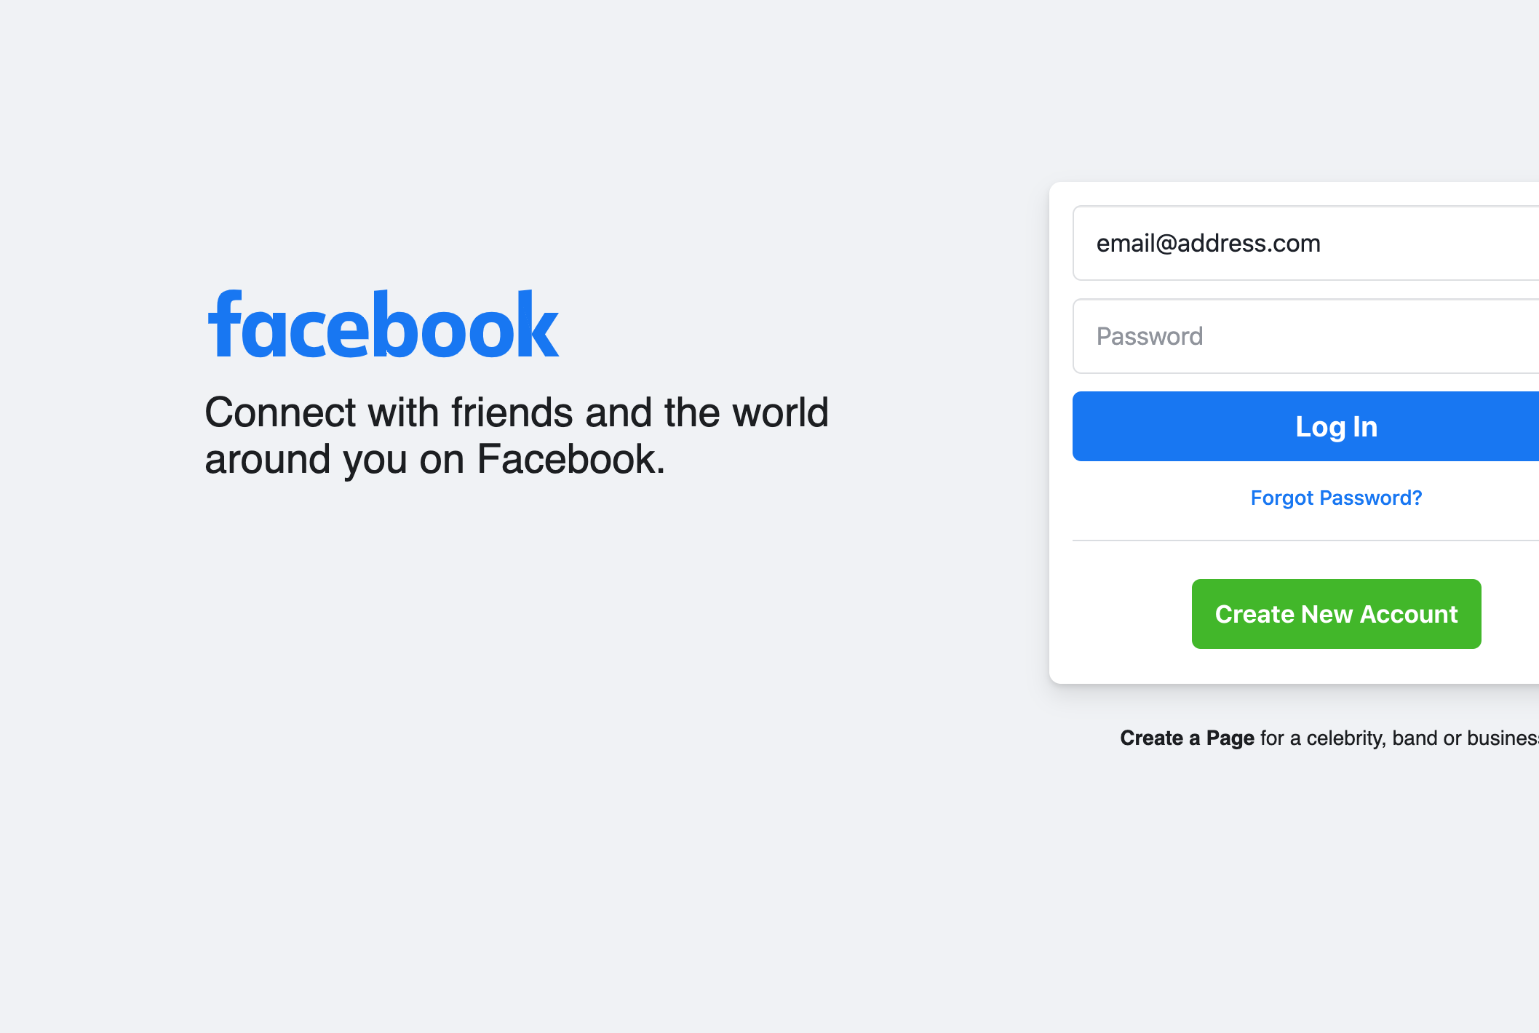
Facebook
Notes:
0:54
Facebook, of course!

Slide 27
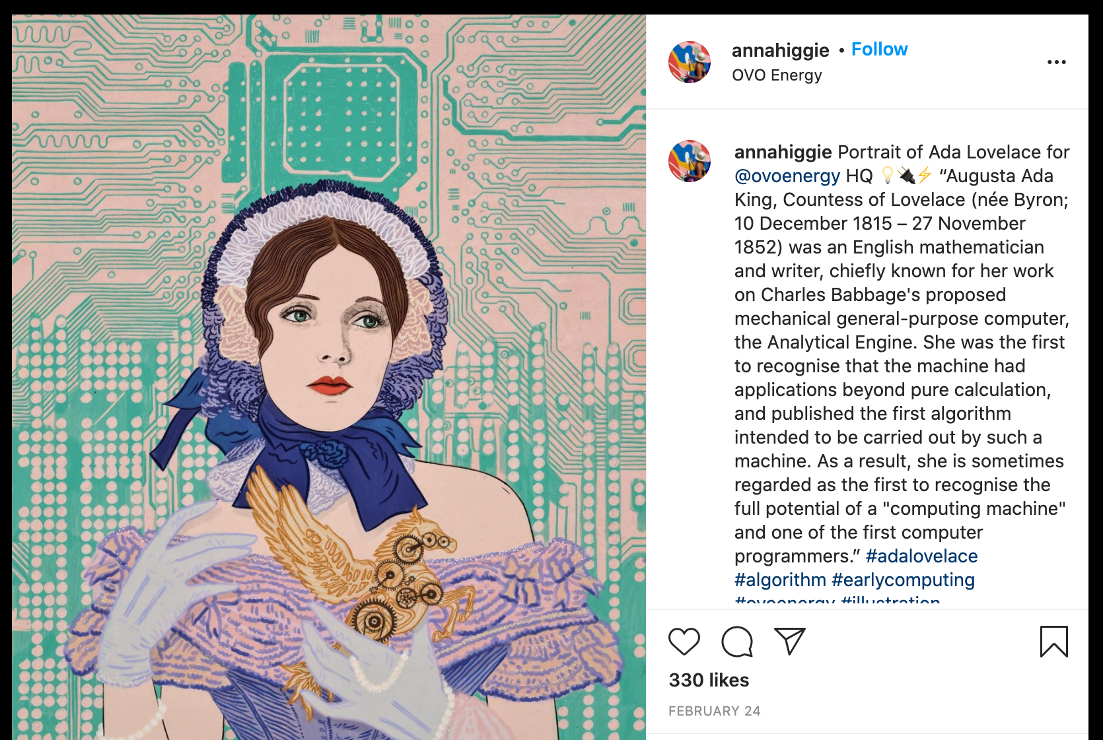
Instagram
Notes:
0:54
Instagram also uses React

Slide 28
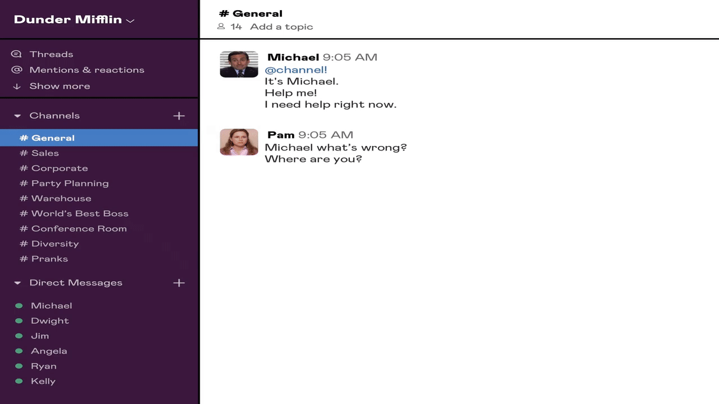
Slack
Notes:
0:54
Slack uses React, and packages this web experience inside of wrapper applications for each major platform like Windows, Mac and Linux.

Slide 29
Other Examples
Khan Academy
Dropbox
Tesla
Airbnb
Netflix
Notes:
0:54
Other notable examples of companies that use React are:
Khan Academy
Dropbox
Tesla
Airbnb
Netflix
There are other competitors to React, such as Angular or Vue. React has been a very popular choice for developers and continues to be a leader in web development. Although this could change quickly, you won’t be wasting any time learning React because the concepts apply to other libraries and are all good software development practice.

Slide 30
Why are they using it?
Makes managing complex interfaces much easier
Development is led through JavaScript which plays well with lots of other platforms/tools/etc
Notes:
0:55
Say: Companies choose to use React because it has such a strong community of supporting developers, it has great performance and has a relatively low learning curve. Another important reason is that React is built with JavaScript, which is a very popular programming language that can run on the front end (like web pages) or the backend (like web servers). With one language being used in both the front and back end, it makes it easier to find great developers that could work in either area.

Slide 31
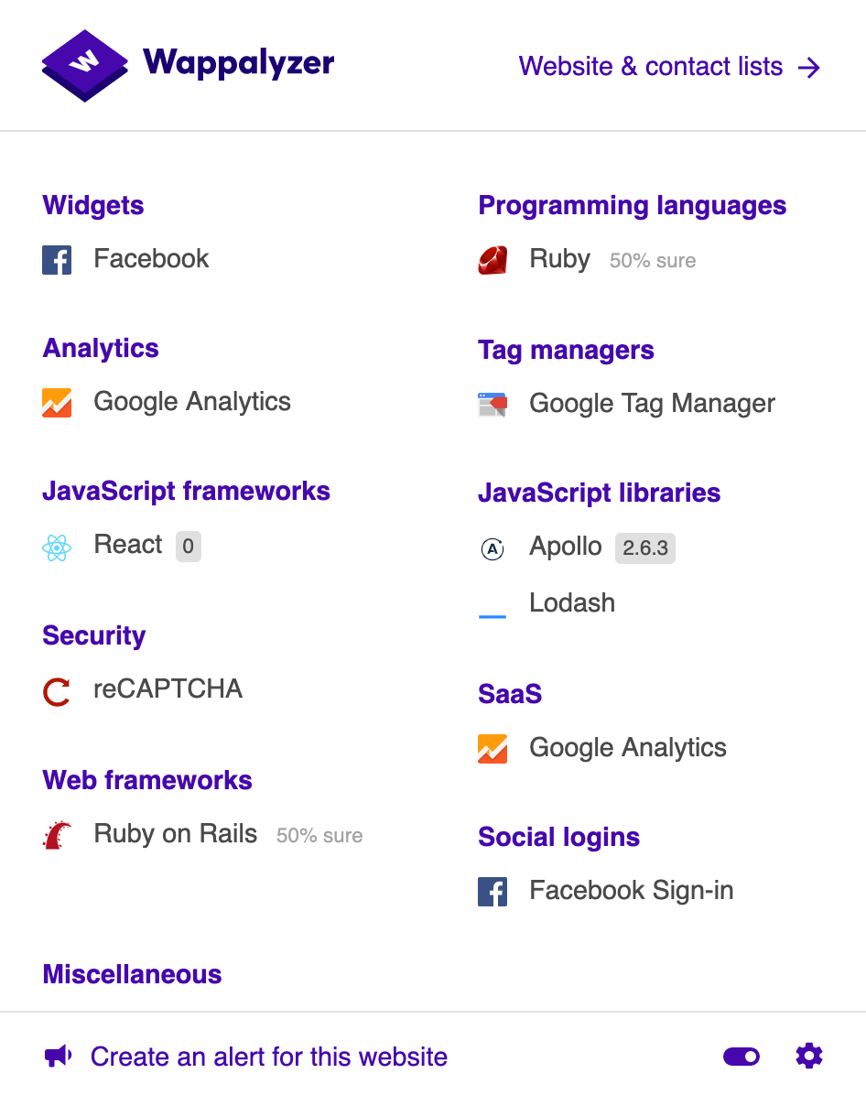
Seeing What A Site is Made Of
Websites leave clues in their HTML, JS, and CSS code that allows you to make a pretty good guess as to what tools may have been used to make them.
The following tools can be used to quickly tell you what a site is built with.
BuiltWith Chrome Extension
Wappalyzer Chrome Extension
Notes:
0:57 – 1:00
It can be fun to know what tools or technologies a company is using to build their website. Websites leave clues in their HTML, JS, and CSS code that allows you to make a pretty good guess as to what tools may have been used to make them.
The following tools, which are Chrome extensions, can be used to quickly tell you what a site is built with.
BuiltWith
Wappalyzer
Exercise: Let’s take a quick look at how you can use this type of tool.

Slide 32
Learning More About Web Development
Our next session will have you dive right into the code to learn how to create a new React app on your computer as well as some other introductory concepts.
In addition to attending that session, some other ways you can learn React are:
Online courses that cover HTML, JS, and/or CSS to build more foundational knowledge and learn more of the HTML building blocks that pages are built of, such as lists, and tables.
Build foundational knowledge in js, css, html but don’t worry if you don’t know everything about them because you will continue learning more as you dig in to React itself
Pick one of the React learning courses below and dig in to that
Practice with example projects
Participate in the community through meetups, webinars, open source, etc
Come to our next session
Notes:
1:00 – 1:05
Say: The last thing that we will discus today before answering any questions that you might have is how to learn more about web development.
As we mentioned earlier, we are going to host a second part to this presentation where we go further into React.js and get some hands on experience building and publishing a web page with React. Keep an eye out for an email with the date and registration link for that session.
One of the coolest things about software development is that you can learn almost everything that you need to know from free resources that are available to you. There is an endless amount of tutorials, videos, programming language documentation sites, and other references. Let’s talk about some of the options that we would recommend exploring if you want to learn more:
Online courses that cover HTML, JS, and/or CSS to build more foundational knowledge and learn more of the HTML building blocks that pages are built of, such as lists, and tables.
Build foundational knowledge in js, css, html but don’t worry if you don’t know everything about them because you will continue learning more as you dig in to React itself
Pick one of the React learning courses below and dig in to that
Practice with example projects
Participate in the community through meetups, webinars, open source, etc
Come to our next session

Slide 33
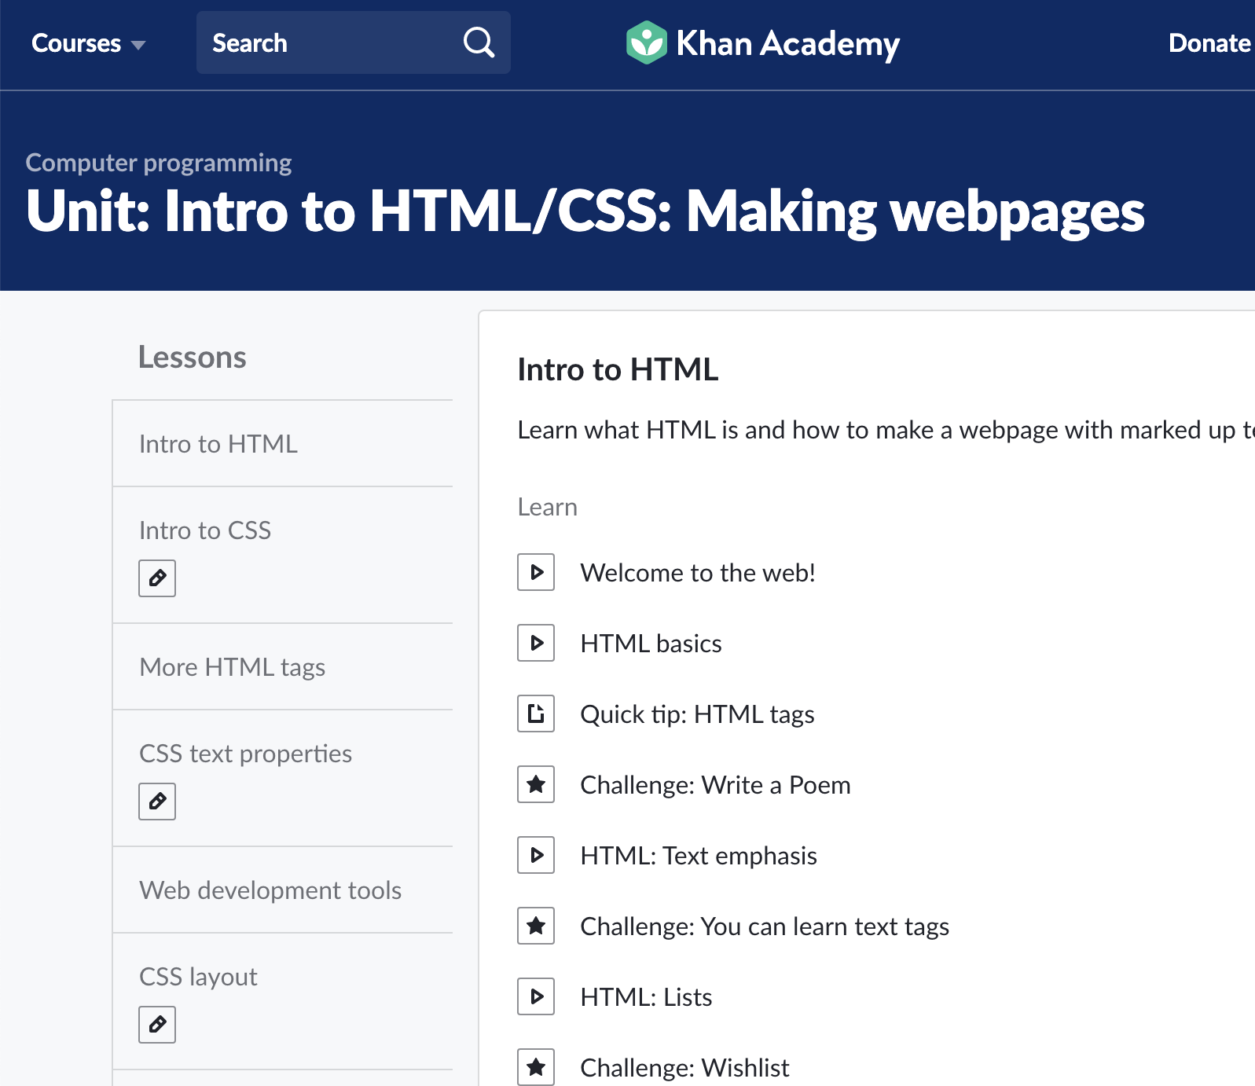
Khan Academy
Free online courses
Use sites like this to learn HTML, JS, and/or CSS to build more foundational knowledge and learn more of the HTML building blocks that pages are built of, such as lists, and tables
Notes:
1:05
Say: We want to highlight Khan Academy because they have some great content and are completely free. Khan Academy has way more than just software education, so definitely check it out when you have some time and are in the mood to learn.

Slide 34
Your Public Library
Many public libraries have resources available to you such as:
Lynda.com or other paid learning memberships
Ebooks that can be checked out from home
Programming Books
Notes:
1:05
Many people don’t know this, but your public library has resources for you that can be extremely helpful when learning to program. It differs from library to library, but examples of what may be available are premium subscriptions to video tutorial services like Lynda.com or PluralSight, or Ebooks that you can check out right from a mobile device or computer.

Slide 35
Other Internet Sources
YouTube
Endless videos that show off programming concepts
Google
Googling an error message can be a quick way to help you learn how to overcome a mistake.
StackOverflow
Sites such as StackOverflow are used daily by professional developers in a real workplace to quickly solve their issues rather than spending unnecessary time investigating the cause.
Notes:
1:10
Other free internet sources are great places to learn as well. One thing to keep in mind is that the best way to learn is to set goals and work to accomplish them. Try to build real things that you care about, whether it’s a website, a game, or a mobile app. The more that you try to practice writing code, the more questions that you will be googling! This is “experience” and this is one of the things that employers will be looking for when they interview you for an entry level software developer job.

Slide 36
Questions?
Notes:
1:10
We have talked about a lot today! We hope that this information has been a helpful introduction. If you already knew all of this, hopefully it helped refresh a few things or give you a new way to think about how the internet works. If this was all new to you, please feel free to reach out with any questions that you might have!

Slide 37
Thank you!
Notes:
1:15
Thank you for coming! If you have any feedback about the session please feel free to reach out and please leave feedback via the survey that you will receive from BGC!

